Slide 1

Optimizing Cosmetic Formulations Using Product Reformulation Trends
Olivia Folly-Gah

Slide 2
Objective
Identify trends in cosmetic product reformulations due to hazardous ingredients.
Sub-Objectives:
Finalize Target Column: Decided on the target column for classification.
Class Imbalance Handling: Implement techniques like SMOTE to address class imbalance.
Model Development: Develop and train machine learning models (Logistic Regression, Random Forest, Gradient Boosting, XGBoost).
Model Evaluation: Assess models using cross-validation, accuracy, and AUC.
Notes:
focusing on overcoming challenges related to class imbalance, model evaluation, and fine-tuning.

Slide 3
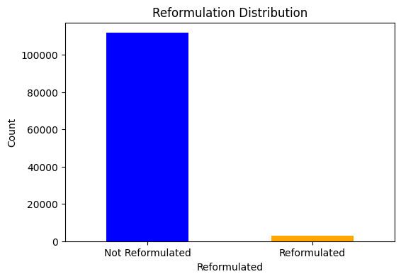
Understanding
Overview of the Dataset: worked with a highly imbalanced dataset. The task was binary classification, where one class (Class 1) is significantly underrepresented.
Model Selection: Chose Logistic Regression, Random Forest, Gradient Boosting, and XGBoost for classification tasks.
Evaluation Metrics: Focused on accuracy, precision, recall, and ROC-AUC score to evaluate model performance comprehensively.
Notes:
Reformulated
0 111650
1 2985
Reformulated Percentage: 2.60%
Since Reformulated is highly imbalanced (only 2.6% reformulated), using it directly as a target for classification would be difficult unless you handle the imbalance carefully (e.g., SMOTE, undersampling, or cost-sensitive models).
Best Options Based on Your Data:
If you want a simple binary classification → Go with Reformulated but apply resampling techniques (oversampling, SMOTE, or class-weighted models).
If you want a better-balanced classification → HazardType has better distribution, but "Not Hazardous" still dominates (~90%).
If you want a regression approach → ChemicalAge is highly skewed (most near 0, some >30,000), so it might need log transformation to make it more usable.

Slide 4
Challenges
Target: HazardType
Target: ChemicalAge
( Multi-Class Classification )
Not Hazardous, Suspected Carcinogen, Confirmed Carcinogen
Pros: Captures different reformulation risks ✅
Cons: Possible class imbalance ❌
Alternative: Group hazards into fewer categories (e.g., Safe, Medium Risk, High Risk)
( Regression )
Number of days before reformulation
Pros: Shows how long chemicals stay before removal ✅
Cons: Harder to interpret in categorical modeling ❌
Definition: Time difference between InitialDateReported and ChemicalDateRemoved
Notes:
Instead of a simple Yes/No classification, this approach categorizes products based on the type of hazard they present.
This can provide deeper insights into the reasons behind reformulation.
However, the dataset may have an imbalance issue across different hazard categories.
Grouping similar hazard types into broader categories could help mitigate this.
This approach treats reformulation as a time-dependent variable.
It provides insights into how long hazardous chemicals remain in use before being removed.
The downside is that it is less interpretable compared to categorical modeling approaches.

Slide 5
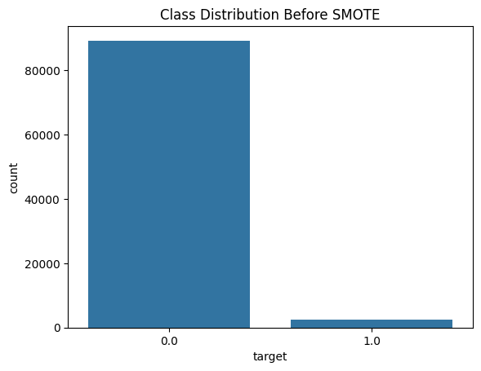
Reformulation (Yes/No)
Binary Classification (Yes/No)
Pros: Simple and interpretable ✅
Cons: Imbalanced if few products are reformulated ❌
Definition: A product is reformulated if ChemicalDateRemoved is not NaN
Class Imbalance
Class Imbalance:
The target variable had significantly more instances of Class 0 than Class 1.
This led to skewed predictions and poor model performance for Class 1.
Target: Reformulated (0 = No, 1 = Yes)
Before SMOTE: Counter({0.0: 111650, 1.0: 2985})
Notes:
The goal of this project is to understand how and why products are reformulated in response to hazardous ingredients, so to achieve this, we need to define a target variable that effectively captures reformulation trends.

Slide 6
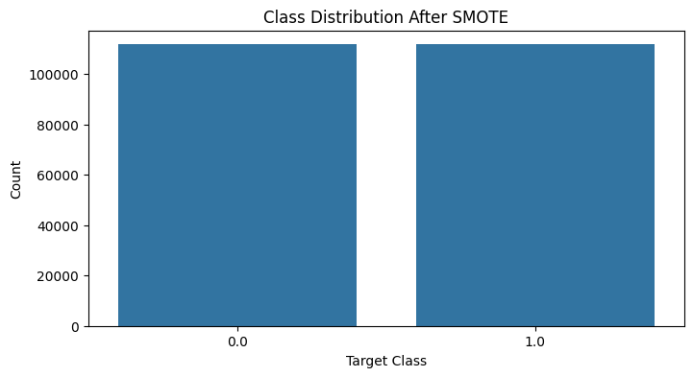
After Applying SMOTE
SMOTE for Class Imbalance:
Used Synthetic Minority Over-sampling Technique (SMOTE) to oversample the minority class (Class 1) and balance the dataset.
After SMOTE: Counter({0.0: 111650, 1.0: 111650})
Notes:
Instead of removing majority class data (which leads to loss of information), I used SMOTE to generate synthetic reformulated product cases.
This technique preserved the structure of my dataset while improving class balance.

Slide 7
Solutions
Feature Scaling
Standardized numerical features to improve model performance and prevent convergence issues.
Cross-Validation & Hyperparameter Tuning
Used cross-validation for fair model evaluation.
Tuned hyperparameters for Random Forest to improve performance and reduce overfitting.
Logistic Regression Adjustment
Increased the number of iterations to resolve convergence issues.
Notes:
Feature scaling ensured all numerical features were on the same scale, preventing issues with model training.
Cross-validation helped validate model performance, and hyperparameter tuning improved overall accuracy.
Logistic Regression initially had convergence issues, which were fixed by increasing the iteration limit.

Slide 8
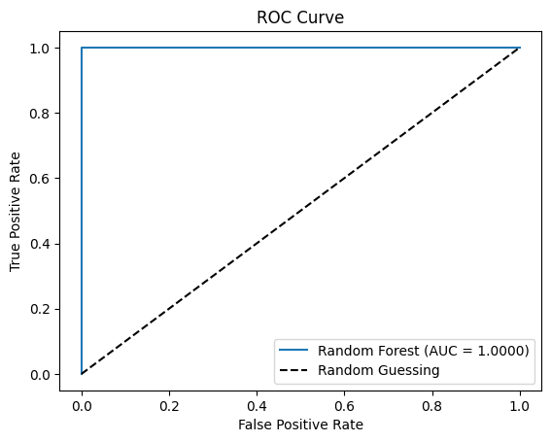
Results
Cross-Validation Accuracy:
Logistic Regression: 97.92%
Random Forest: 100%
Gradient Boosting: 99.99%
XGBoost: 99.99%
Classification Report for Best Model (Random Forest):
Precision for Class 0: 1.00
Recall for Class 1: 1.00
F1-Score for Class 1: 0.60
AUC Score: 1.0
Notes:
Despite this, the F1-score for Class 1 was lower, indicating some issues with false positives.
This suggests potential overfitting or imbalance, which may require further adjustments.
Next steps could involve fine-tuning hyperparameters or balancing the dataset further.

Slide 9
Future Plans
1. Reduce Overfitting
Apply regularization techniques to Random Forest and Gradient Boosting.
2. Improve Class 1 Precision
Use resampling techniques and adjust decision thresholds.
3. Enhance Features
Add new features and refine feature selection for better performance.
Notes:
To reduce overfitting, we’ll explore regularization methods.
Improving precision for Class 1 is key, so we’ll fine-tune resampling and decision thresholds.
Feature engineering could further boost performance, so we’ll experiment with additional features.
1. Time-Based Features
Time Since Initial Report – Number of days since the product was first reported with the hazardous ingredient.
Year of Reformulation – Some years may have higher reformulation rates due to regulatory changes.
Time Between Reports – Measure how frequently reformulation happens after initial reporting.
2. Product-Specific Features
Product Category – Certain categories (e.g., cosmetics vs. cleaning products) may have different reformulation trends.
Brand Reputation – Some brands might reformulate faster due to consumer pressure or regulations.
Product Lifecycle Stage – Older products may be less likely to be reformulated.
3. Hazard-Related Features
Number of Hazardous Chemicals – Products with more hazardous chemicals may be more likely to be reformulated.
Hazard Severity Score – Convert categorical hazard levels into a numerical risk score.
Regulatory Flag – Identify whether the chemical is flagged by specific regulatory agencies (e.g., FDA, EPA).
4. Market & External Factors
Consumer Awareness Trends – Use external data like search trends for hazardous ingredients.
Regulatory Policy Changes – Flag if the product’s reformulation aligns with major regulatory updates.
Competitor Actions – If competitors reformulate similar products, it may influence other brands.
5. Chemical-Specific Features
Chemical Type – Categorize chemicals (e.g., heavy metals, endocrine disruptors, carcinogens).
Toxicity Score – Use publicly available databases to assign toxicity scores.
Persistence in Products – Some chemicals may have longer lifespans in formulations before removal.

Slide 10
Conclusion
Key Takeaways
Despite challenges like class imbalance, careful preprocessing and model tuning led to strong results.
The models achieved high accuracy and AUC scores, but there’s room to improve Class 1 precision and reduce overfitting.

